Slide 1



Skill-Based vs. Gambling: A Game Assessment Tool
A web-based solution for classifying games in India
By Krrish Brahmbhatt
Notes:
1

Slide 2
Navigating the Grey Areas
The Challenge
The Solution
Distinguishing skill-based games from gambling in India is complex. It's crucial to ensure clarity and compliance.
A web-based assessment tool provides guidance for developers and regulators, promoting responsible gaming.
Notes:
2

Slide 3
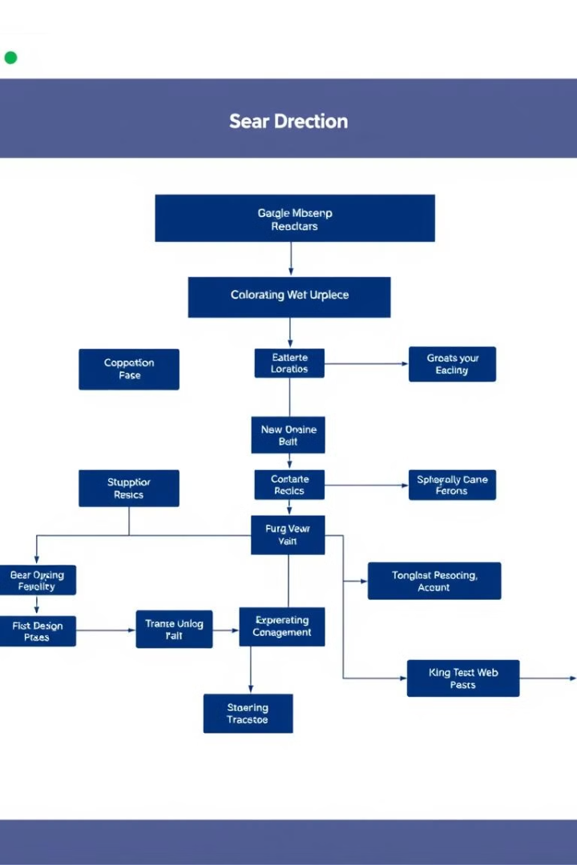
Website Features: A Comprehensive Approach
1
1. Game Assessment Form
2
2. Assessment Algorithm
Developers input game mechanics, rules, and wagering details.
Analyzes input, classifying the game as skill-based or gambling.
3
3. Infographic
4
4. Quiz
Visually explains the key differences between skill-based games and gambling.
Tests user understanding of the concepts and legal landscape.
Notes:
3

Slide 4

Deciphering the Code: Assessment Logic
Factors Analyzed
NLP-Powered Algorithm
Game description, rules, balance of chance vs. skill, presence of wagering or prizes.
Uses keyword extraction, pattern recognition, and weighted scoring for classification.
Notes:
4

Slide 5



A Visual Guide: Understanding the Differences
Skill-Based Games
Gambling
Player skill and strategy determine outcomes.
Outcome based primarily on chance, with a focus on wagering.
Notes:
5

Slide 6

Putting Knowledge to the Test
1
Quiz Purpose
Educate users on the legal and conceptual framework.
2
Quiz Content
Multiple choice questions on skill-based gaming, gambling, and Indian regulations.
3
Quiz Feedback
Provides feedback based on user's score.
Notes:
6

Slide 7
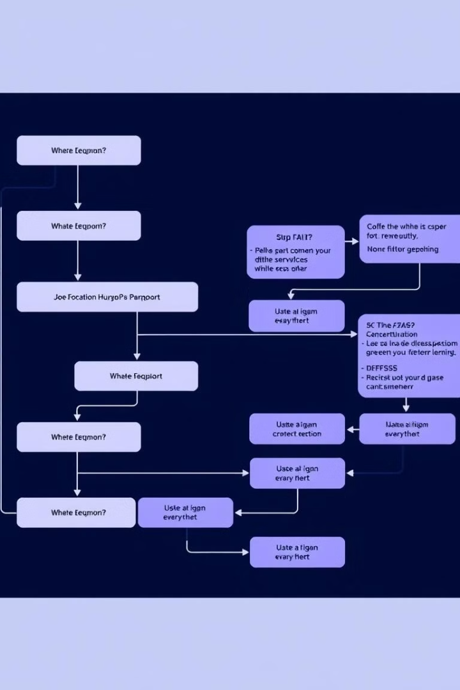



Behind the Scenes: Technology Stack
Frontend
HTML, CSS, JavaScript.
Backend
PHP, MySQL.
Server
XAMPP (Apache, MySQL, PHP).
Notes:
7

Slide 8



Indian Legal Landscape: A Guide
Public Gambling Act 1867
1
Primary legislation governing gambling.
2
State-Specific Laws
Variations in regulations across different states.
3
Court Judgments
Key legal precedents that define "games of skill".
Notes:
8

